Slide 1
Automatic Upload of Electronic Holdings
Springer
Yoel Kortick
Senior Librarian

Slide 2
Agenda
Introduction
The setup
The update from Springer
The update from Springer – No Change to Resource
The update from Springer – Resource Updated
The update from Springer – Resource Added
Summary
2

Slide 3
Introduction

Slide 4
Introduction
In addition to this presentation see also the online help at Upload Electronic Holdings from Springer.
It is possible to both import and continuously update Springer electronic holdings by automatically retrieving the institution-specific holdings using an integration profile.
This feature is advantageous because it can replace the manual, multi-step workflow of contacting Springer for your specific institutional holdings, converting the provided feed to meet the Portfolio Loader format, and then uploading the holdings using the Portfolio Loader.

Slide 5
Introduction
This feature ensures that your institution-specific electronic holdings for Springer collections are up-to-date and reflect your purchases.
To support this capability, the following Springer collections that you need to activate are in the Community Zone:
  SpringerLink Journals - AutoHoldings (Community Zone Collection ID = 613860000000000884)
  SpringerLink Books - AutoHoldings (Community Zone Collection ID = 613860000000000883)

Slide 6
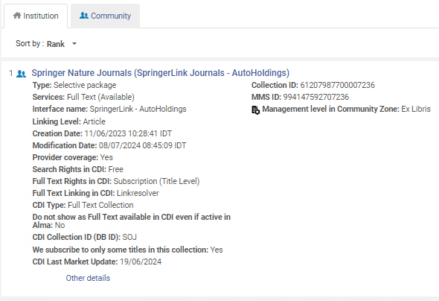
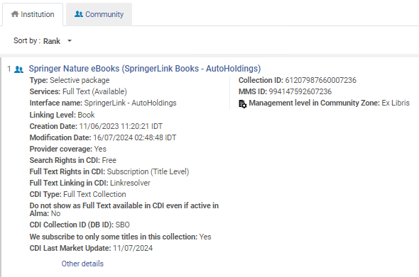
Introduction
Here are the two collections in the institution activated from the community zone. These are the collections which will be automatically updated via the “Upload Electronic Holdings” integration profile for Springer.

Slide 7
The setup

Slide 8
The setup
The first step is to obtain from Springer an institution token.
This is a token used by Springer to identify your institution and thereby provide the holdings files for your institution.
This token will be put into the integration profile.

Slide 9
The setup
The second step is to ensure that the Springer collections for which you are updating holdings are active collections in Alma.
For example: (as we saw in the introduction):

Slide 10
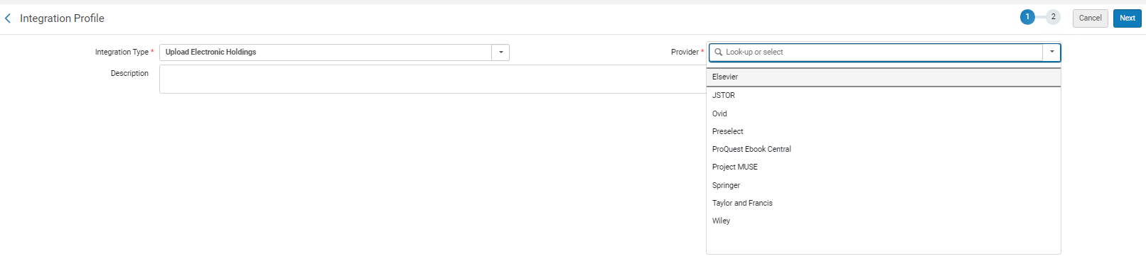
The setup
The third step is to add an integration profile of type “Upload Electronic Holdings” and choose “Springer” as the “Provider”.
This is done from the “Profile List” page at “Configuration > General > External Systems > Integration Profiles”

Slide 11
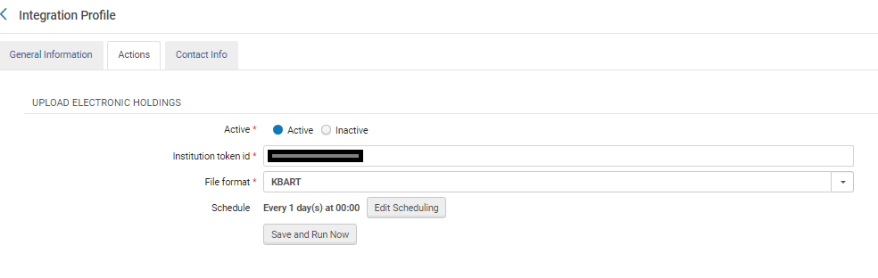
The setup
Fill in the Token ID (which you received from Springer), File Format = KBART, and choose scheduling option.

Slide 12
The update from Springer

Slide 13
The update from Springer
The job “Upload Electronic Holdings” for vendor Springer will run as scheduled. In this case, every day at 00:00
If needed the job can also be run manually

Slide 14
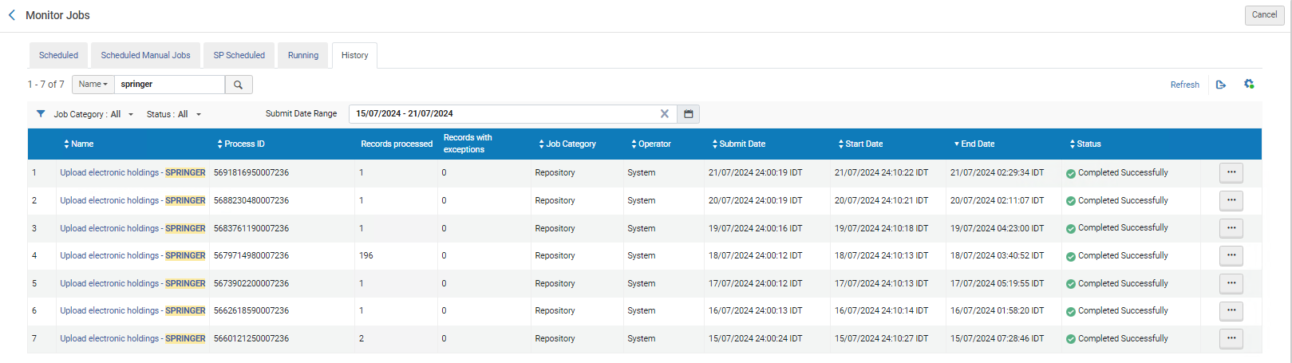
The update from Springer
Here from the “Monitor Jobs” we see the last 7 jobs for “Upload electronic holdings - Springer”

Slide 15
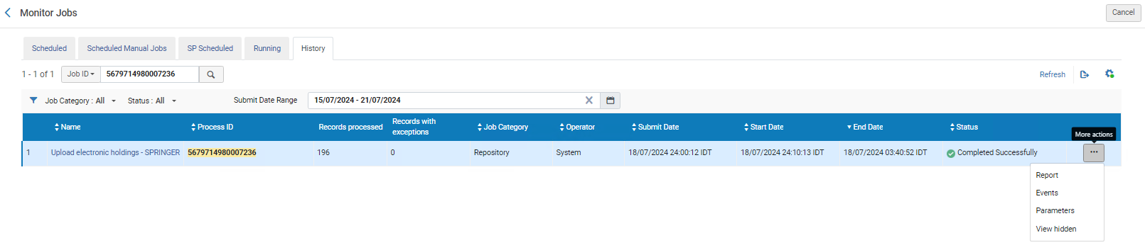
The update from Springer
Let’s take a look at the report for the job run on July 18, 2024.

Slide 16
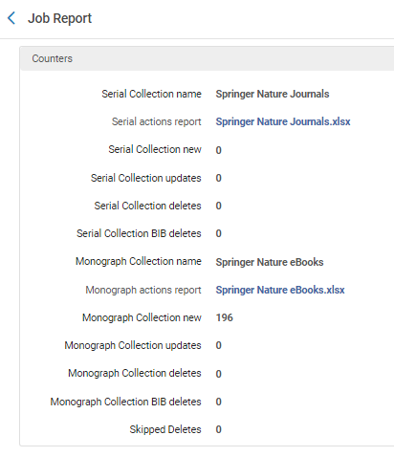
The update from Springer
Two KBART files were provided via the job by Springer
We will download Springer Nature eBooks.xlsx.
We will download this

Slide 17
The update from Springer – No Change to Resource

Slide 18
The update from Springer – No Change to Resource
This is part of the KBART file “Springer Nature eBooks.xlsx” from July 18 supplied by Springer. Here we see for example that Monograph “Addictive Behaviors in Women” ISBN 978-1-4612-6698-3 :
  Is designated as “No Change”

Slide 19
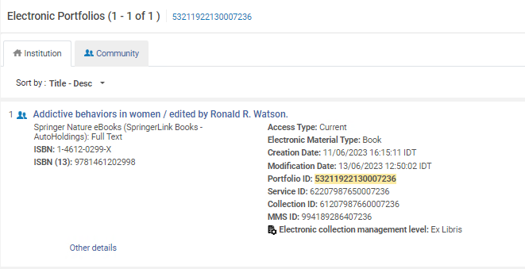
The update from Springer – No Change to Resource
Here is monograph “Addictive Behaviors in Women” ISBN 978-1-4612-6698-3 in Alma
Last modification date is before the last time the job ran on July 18, 2024.

Slide 20
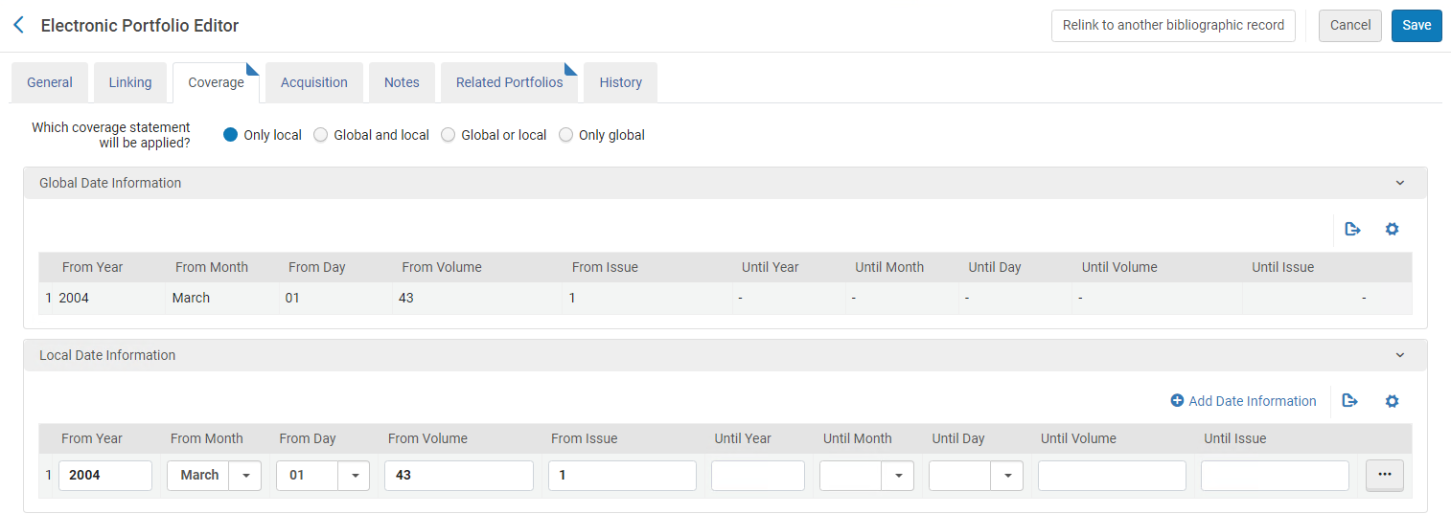
The update from Springer – No Change to Resource
The coverage information which we saw in the KBART file

Slide 21
The update from Springer – Resource Updated

Slide 22
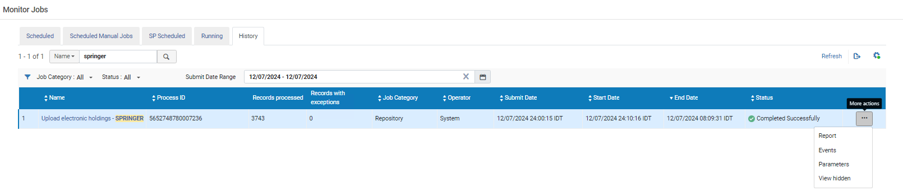
The update from Springer – Resource Updated
We will now look at the report from July 12, 2024

Slide 23
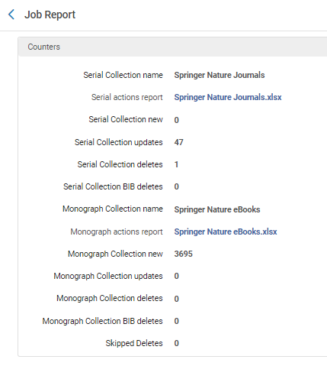
The update from Springer – Resource Updated
We will download the file “Springer Nature Journals.xlsx”
We can see that there are updates in this file

Slide 24
The update from Springer – Resource Updated
This is part of the KBART file “Springer Nature Journals.xlsx” supplied by Springer on July 12. Here we see for example that Journal “ATZextra worldwide” ISSN 2195-1470”:
  Is published from year 2017-11-01 (which is Nov. 2017) vol. 22 issue 2
  The journal was updated in this run of the job

Slide 25
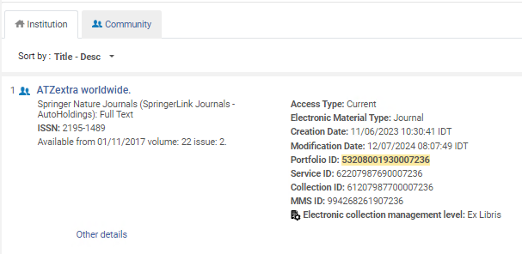
The update from Springer – Resource Updated
Here is journal “ATZextra worldwide” ISSN 2195-1470 in Alma
Last modification date is the date of the last time the job ran on July 12, 2024.
The coverage information which we saw in the KBART file

Slide 26
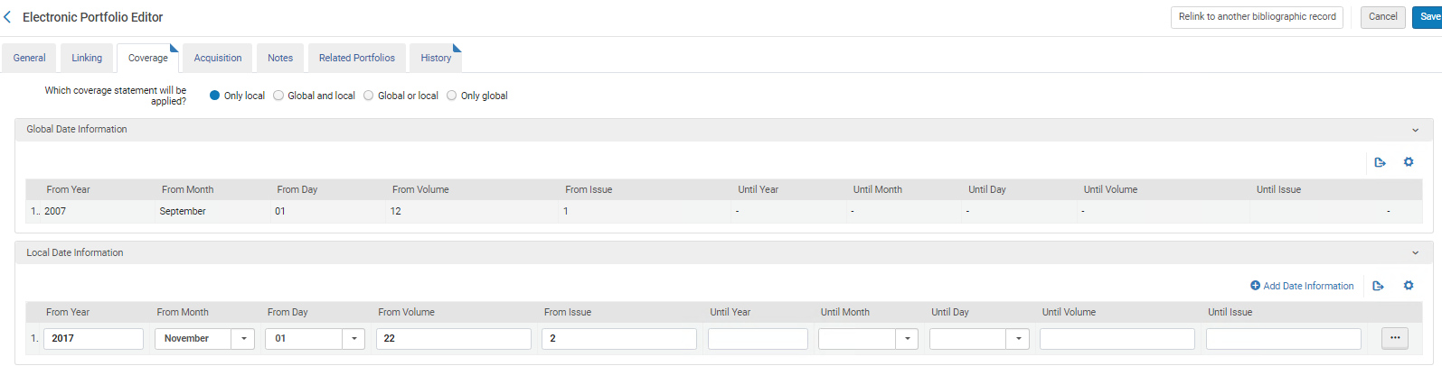
The update from Springer – Resource Updated
The coverage information which we saw in the KBART file

Slide 27
The update from Springer – Resource Added

Slide 28
The update from Springer – Resource Added
This is part of the KBART file “Springer Nature eBooks.xlsx” supplied by Springer on July 18.
Here we see for example that Monograph “Women Entrepreneurship Policy” ISBN 978-981-97-3606-5:
  Was localized and activated. This means it was added to the electronic collection
Coverage is not relevant for Monograph

Slide 29
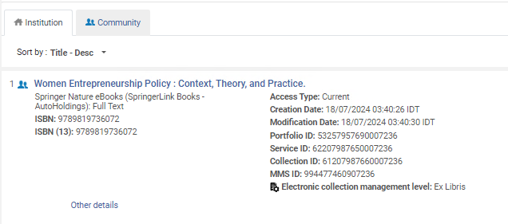
The update from Springer – Resource Added
Here is monograph “Women Entrepreneurship Policy” ISBN 978-981-97-3606-5 in Alma
Last modification date is the date of the time the job ran on July 18, 2024.

Slide 30
Summary

Slide 31
Summary
After a simple setup the institution was able to automatically receive files from Springer, have them upload to Alma, and update the holdings of the electronic resources.
No manual work was done.
This is a great time saver, replacing the need to get the files from the vendor, make sure they are in proper format, and manually load to Alma.

Slide 32
Thank You

